Slide 1
Counter/Reducing Stage Fright

Slide 2
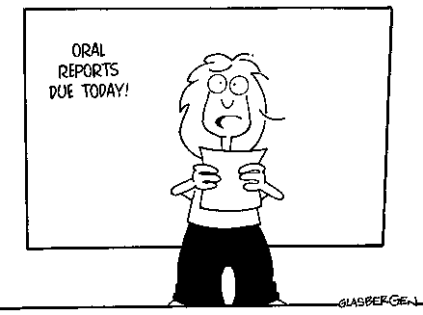
A Phobia An Unreasonable Fear
Called by many names -
A. stage fright
B. speech anxiety
C. shyness
D. fear of speaking
E. performance anxiety
F. Speech phobia
Fear of public speaking can have a negative effect on careers and the ability to get things done, and therefore on your success.

Slide 3
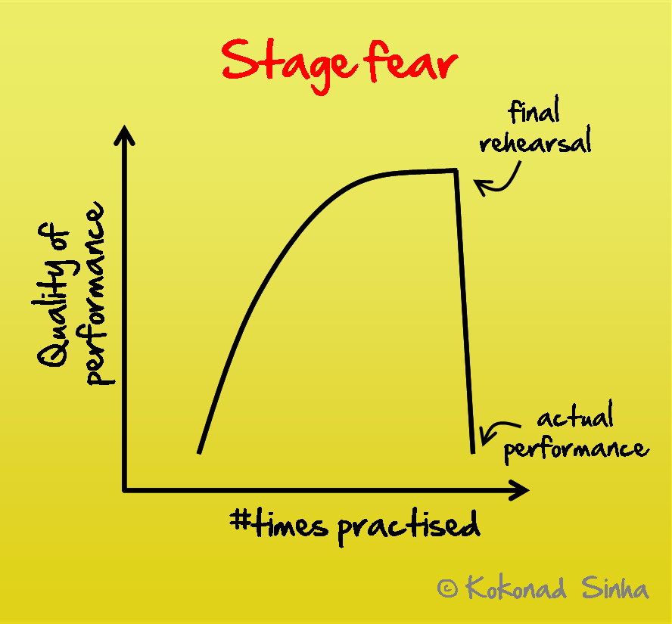
THIS USUALLY HAPPENS!

Slide 4
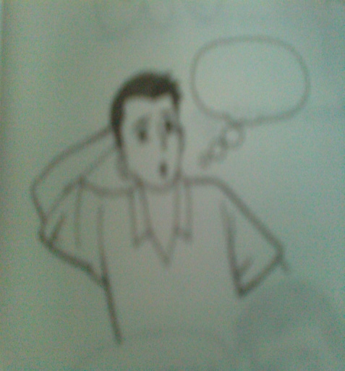
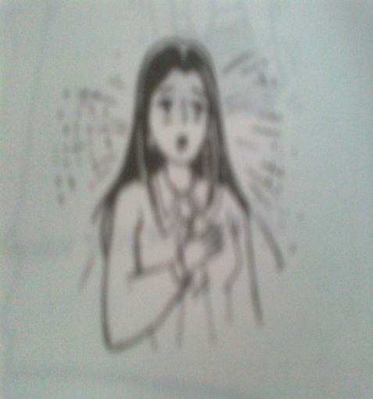
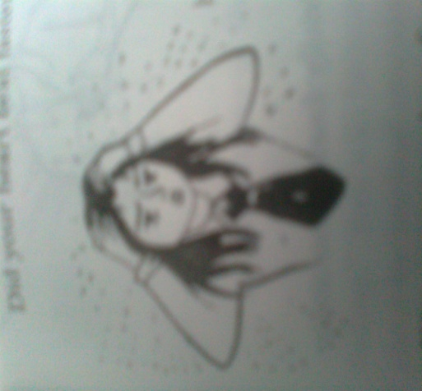
Did you experience a mental blackout?
Did your heart beat faster than usual?
Did you feel your blood rushing to your head and to your cheeks?

Slide 5
QUESTIONNAIRE ON SPEECH ANXIETY
1- NONE 2- VERY SLIGHTLY 3- SLIGHTLY
4- INTENSE 5- VERY INTENSE
___1. weak voice
___2. shortness of breath
___3. awkward pauses
___4. preference to look up/down
___5. rapid heartbeats
___6. playing with pen/hanky

Slide 6
QUESTIONNAIRE ON SPEECH ANXIETY
1- NONE 2- VERY SLIGHTLY 3- SLIGHTLY
4- INTENSE 5- VERY INTENSE
___7. no eye contact with the audience
___8. moving too much
___9. trembling hands
___10. feeling cold
___11. inability to think clearly
___12. dry mouth and throat

Slide 7
QUESTIONNAIRE ON SPEECH ANXIETY
1- NONE 2- VERY SLIGHTLY 3- SLIGHTLY
4- INTENSE 5- VERY INTENSE
___13. no facial expression
___14. wanting to end speech
___15. to fast rate of speech
___16. feeling dizzy
___17. feeling awkward and clumsy
___18. perspiring too much

Slide 8
Performane & Inner Strenght …..
‘Take an active approach to the problem of performance anxiety – don’t let it ruin your life’

Slide 9
How to be an effective performer????

Slide 10
Where are you????

Slide 11
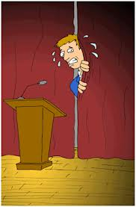
Or is it you????

Slide 12
What is stage fright?
The term stage fright has been defined in various ways. Definitions that are used frequently are those of Salmon (1990) and Brodsky (1996):

Slide 13
CONTINUED….
The definitions show that stage fright is a state of being, especially directed towards the future (Kenny et al. 2006).
At the core, according to Barlow Definition of the Problem (2000), is a feeling of a lack of control about future events which are important to the person.

Slide 14
The thought of failing is very threatening to the self-image of the individual. Between the threats of possible dangers and the experienced fear, there is the following interchange, according to Kenny (2006):

Slide 15
Stage fright consists of the following components ……
Physiological component: changes in our nerve system and hormonal system which amongst other things might lead to an increased heart rate or pulse, dry mouth, sweaty or trembling hands, nausea, shortness of breath and blurry eyesight; the physical excitement is a natural response to the situation and is related to the flight or fight response with which people have reacted to frightening situations as of old.

Slide 16
a cognitive component:
Having trouble concentrating, experiencing a black-out, a heightened awareness (being too focused on oneself and not enough on the task), being too focused on how others perceive him or her, negative thoughts about own abilities and the performance, and a distorted perception (wrong notes are experienced as more disastrous than they really are to others – listeners).

Slide 17
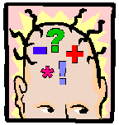
COGNITIVE STRATEGIES
Most detrimental - catastrophising:
“I think I am going to faint”
“I’m sure to make a dreadful mistake and that will ruin everything”
Best kind - realistic appraisal:
“I’m bound to make a few mistakes, but so does everyone.”
“The audience wants me to play well and will make allowance for a few slips”.

Slide 18
 An affective component:
experiencing fear, panic, insecurity, and feelings of inferiority.

Slide 19
A behavioral component:
more trouble with moving naturally, more mistakes, less expressive playing (or too exaggerated), more irregularities
more general behavioural changes, such as avoidance, irritation, use of medication, etc.)

Slide 20
These components influence each other mutually. Negative thoughts (cognitive) about the performance lead to heightened physical symptoms (physical), which increase the chance of making more playing mistakes (behavioural), with as a result an impaired self-image (emotional), which causes negative thoughts and physical reactions to be stronger during a next performance.

Slide 21
The cognitive component, as is shown by research, is the most important factor in maintaining and increasing stage fright. According
to the catastrophe-theory cognitive fear, accompanied by physical tension,
leads to intensification of the stress reaction with as a consequence a drastic drop in performance levels……..

Slide 22
People who suffer from performance anxiety suffer especially from the fear of being observed and criticized . It occurs in people who want to impress others in a certain situation, but who lack the belief in their own capacities that allow them to meet these expectations.

Slide 23
The evolutionary advantage of performance anxiety (in a mild form) lies in the fact that, in order to impress others, fear stimulates the individual to prepare well, which increases the chance of a good result and therefore appreciation (acceptance) by others. In the first case the pressure is greater because the individual is completely responsible for the achievement.

Slide 24
What causes stage fright?
Personal traits related to stage fright are:
Hypersensitivity: which can be traced back to a nerve system that reacts more strongly to external stimuli;
A perfectionist attitude: people who are often not easily satisfied about themselves; this may be caused also by the pressure the person feels from her or his environment: I cannot let them down.
Kenny, Davis & Oates (2004) found that in experienced performers perfectionism strongly correlated with trait-anxiety.

Slide 25
CONTINUED……
An anxious person: introverted and neurotic people in general are more anxious (Kemp, 1996; Steptoe & Fidler, 1987);
Social phobia: people who are preoccupied with thoughts about how others think about them;
Pessimistic attitude to life: people who are more pessimistic and therefore more susceptible to fear and depression;
People with fewer (effective) coping strategies (knowing how to deal with fear) experience more feelings of powerlessness, which makes them anxious;
Insufficient technique. Havas (1983) states: The root of most problems concerning stage fright lies in forced and faulty physical actions. The problems of the mental attitudes often arise merely as a result of physical distortions (p. 127);

Slide 26
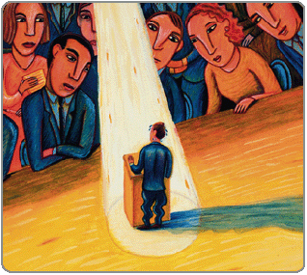
HOW CAN YOU OVERCOME STAGE FRIGHT?

Slide 27
What can be done about stage fright?
There are different strategies, methods and therapies for dealing with stage fright:
Medication, with beta-blockers used most frequently; they decrease physiological symptoms, but not always the stress as it is felt; it can lead to ‘flat’ playing.

Slide 28
CONTINUED
Relaxation techniques such as yoga, meditation, autogenously training. As yet there is insufficient research data of good quality to make definite statements about the effectiveness of these techniques.
Attitude and mental therapies such as the Alexander therapy(FOR MUSICAL PERFORMANCE), Mensendieck etc. There are indications that the use of the Alexander technique leads to improvements in the quality of the performance and a reduction of the experienced fear in stressful situations;

Slide 29
Bio- and neuro feedback in the shape of self-regulation of the heartbeat or brain waves by breathing techniques, mental exercises and visual feedback of the heart rhythm pattern of the brain activities. Among these is the HeartMath method (Thurbe, 2006) and the alpha/theta training by Egner & Gruzelier (2003). Turbe found a significant reduction of stage fright in the group that was trained with the HeartMath method.
The integrated approach of Niemann, Pratt & Maughan (1993), bio feedback training, consisted of the development of breathing awareness, muscle relaxation and performance-coping imagery. The techniques have an immediate effect on reducing physical reactions and indirectly on the cognitive aspects of stress.

Slide 30
Hypnotherapy
Stanton (see Kenny, 2005) found a significant decrease in experienced anxiety among test subjects who received hypnotherapy. The research was based on self-evaluations, the students were not tested in a performance situation.

Slide 31
Realistic thinking:
not making the event too big; you do not fail as a person after a performance that went less well; letting go of delusions of grandeur;
the audience is not your enemy; people will still like you even if you perform less for once. Much research has been done into the area of positive thinking. Many researchers conclude that especially the absence of negative thoughts prior to and during the performance is the explanatory factor for a decrease in anxiety (for an overview see Kenny, 2005).
Considering that the cognitive component is the most important component in maintaining and worsening of stage fright, apparently the following strategies work well: learning to accept that a certain measure of anxiety and making small mistakes during a public performance are normal; learning to enjoy the performance instead of wondering what the audience will think the whole time; and encouraging yourself and focusing on realistic task oriented thoughts.

Slide 32
 Practising:
‘overlearning’ (sometimes this works and sometimes it doesn’t). Excessive practicing can also increase anxiety. A better approach is the systematic variation of the performance conditions and gradually incorporating more conditions as in the concert situation. This is congruent with knowledge from kinetic research (building up flexible movement schemes; see Gellrich, 1998).

Slide 33
Visualisation
imagining the performance, often in combination with a relaxation technique. Objective is that the presenter is able to imagine the performance without experiencing anxiety. This appears especially to reduce cognitive anxiety (see Thurbe, 2006)

Slide 34
Countering distracting/destructive thoughts
by concentrating on the music, and seeing your role as performer and a mediator between the composer and the listener. Task concentration training (TCT), aimed at a better division of the attention between the performer, the performance and the environment is a technique which allows the musician to focus more on the task instead of on him or herself. Van der Loo (2008) found among music students who underwent this training a significant effect on experienced stage fright.

Slide 35
Psychotherapy
Behavioural therapy (aimed at behavioural symptoms), cognitive therapy (explaining the problem, making it possible to talk about the problem), therapy that gives insight (for underlying problems in the personality structure).
Many trainings for dealing with stage fright contain elements which are derived from behavioural therapy or cognitive therapy.
Research into how insight providing therapies work, into the deeper causes of stage fright, does not exist.

Slide 36
Insight into what drives you:
wondering why it is you who make presentation.
How do you want to function as a Speaker?
What makes the subject special for you? What is your own individuality, without comparing your achievements (in part) to those of others?
Aspects that have to do with self-image and identity.

Slide 37
The best way of learning how to deal with stage fright is self-examination and taking charge of the measures that best fit you to combat anxiety

Slide 38
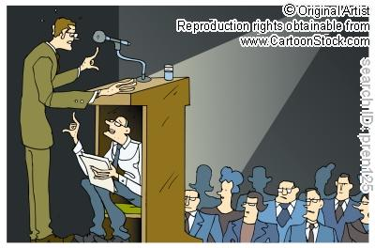
+ Be extremely well prepared + Organize your speaking notes + Absolutely memorize your opening statement + If you have to Practice, practice, practice. + Especially practice bits so you can spit out a few minutes of your program no matter how nervous you are. + Anticipate hard and easy questions + Stay calm, cool, and positive + Smile now and then, and maintain eye contact
HOW YOU CAN DO IT…

Slide 39
Controlling the Symptoms
Recognize the stress as excitement.
The physiological symptoms associated with public speaking are virtually the same as those you’d experience if you rode a roller coaster, went on your first rafting trip, or got married. The real difference is that you have learned to associate “fright” with being on stage and “fun” with being on a roller coaster. The goal of stage fright control is not to make the symptoms go away; the goal is to learn ways to make the adrenaline rush work for you, rather than against you.

Slide 40
Visualisation Strategies
Concentrate on how good you are.
Pretend you are just chatting with a group of friends.
Close your eyes and imagine the audience listening, laughing, and applauding
Remember happy moments from your past.
Think about your love for and desire to help the audience.

Slide 41
Strategies Just before the Presentation
Be in the room at least an hour early, if possible, to triple check everything.
Concentrate on searching for current and immediate things that are happening at the event that you can mention during your speech (especially in the opening).
Get into conversation with people near you.
Look at your notes.
Take a quick walk.
Concentrate on the ideas.
Concentrate on your audience.
Hide speaking notes around the stage area so you know you have a backup if you happen to draw a blank.
Shake hands and smile with attendees before the program.
Double-check your A/V equipment
Say something to someone to make sure your voice is ready to go.
Go somewhere private and warm up your voice, muscles, etc.
Go to a mirror and check out how you look.
Breathe deeply, evenly, and slowly for several minutes.

Slide 42
Use your large muscles. Those contracted muscles are waiting for you to throw a spear at a mastodon, and until you do, they can’t relax. Walk briskly around the building a couple of times (watching out for wild animals, of course.) Throw your arms around, or punch at a nearby wall. Clench your fists, scowl, make ugly faces, and then relax those smaller muscles too. Focus on your back and neck muscles, stretching and rolling your head until they relax.

Slide 43
Take deep breaths, from the diaphragm. Regulating the breath cycle is the most accessible technique for changing the body’s kinesthetic state. (Other techniques include meditation, trance inducement, alternate nostril breathing and other yoga exercises, and biofeedback.) As you force yourself to take a deep breath, the oxygen/carbon dioxide balance is restored, and the body interprets the big sigh as an “all clear” signal. As the stress levels begin to decline, so will the rest of the symptoms.

Slide 44
Watch what you eat. For many people the most debilitating symptoms of stage fright are the consequences of the digestive system shutting down. Figure out what your own digestive system does (or doesn’t do) under stress, and see that you time your food intake to accommodate it. Advice varies from person to person, but here’s a list of the most common solutions to various problems:

Slide 45
1.Avoid milk. It creates phlegm, which is unpleasant and can be annoying while you speak.
2. Maintain sugar levels. Because you are under stress, the body is using up its high-energy sugar reserves, but you will not feel the normal hunger pangs. You have no desire to eat—the thought of food might even make you “feel sick”—but you nevertheless can begin to feel the effects of low blood sugar: depression, anxiety, irritability, lack of concentration, forgetfulness, confusion, headache, body tremors, cold hands and feet. My, don’t those all sound like “stage fright” symptoms!
3. Eat sensibly: Your best bet is to eat a low-fat meal of complex carbohydrates a couple of hours before the presentation.
4.Avoid alcohol, nicotine and caffeine. All stimulate the adrenal glands and increase stress symptoms. On the other hand, if you are a smoker this is probably not a good day to quit.

Slide 46
+ Be extremely well prepared + Organize your speaking notes + Absolutely memorize your opening statement + If you have to Practice, practice, practice. + Especially practice bits so you can spit out a few minutes of your program no matter how nervous you are. + Anticipate hard and easy questions + Stay calm, cool, and positive + Smile now and then, and maintain eye contact
HOW YOU CAN DO IT…

